Slide 1
Digital Circuit Experiment
Lecture 1
聂仁灿（RenCan Nie）

Slide 2

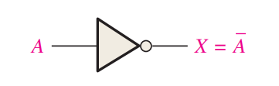
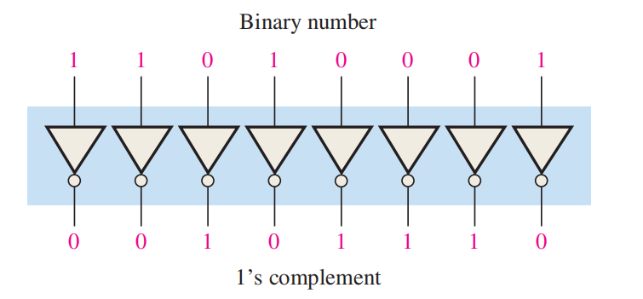
Theoretical Basis
Not gate
The not gate is an inverter, which can be expressed as follows: If the input variable is called A and the output variable is called X, then
This expression states that the output is the complement of the input. If A = 0, then X = 1, and if A = 1, then X = 0.
Truth table for NOT
Input | Output
0 | 1
1 | 0

Slide 3

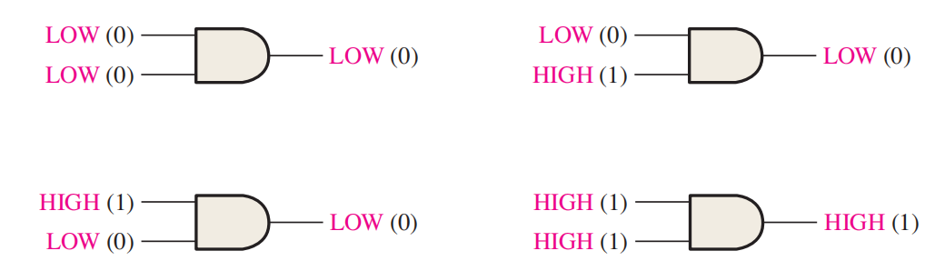
Theoretical Basis
And gate
The 2-input and gate can be expressed in equation form as follows: If one input variable is A, if the other input variable is B, and if the output variable is X, then the Boolean expression is
To extend the AND expression to more than two input variables, simply use a new letter for each input variable. The function of a 3-input AND gate, for example, can be expressed as X = ABC, where A, B, and C are the input variables. The expression for a 4-input AND gate can be X = ABCD, and so on.
Truth table for AND
Input |  | Output
A | B | X
0 | 0 | 0
0 | 1 | 0
1 | 0 | 0
1 | 1 | 1

Slide 4

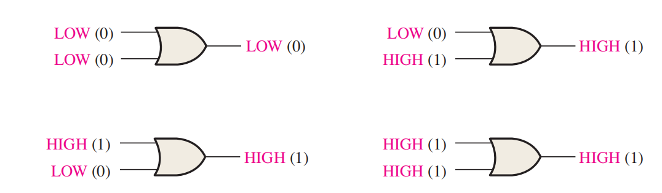
Theoretical Basis
Or gate
The 2-input or gate can be expressed as follows: If one input variable is A, if the other input variable is B, and if the output variable is X, then the Boolean expression is
To extend the OR expression to more than two input variables, a new letter is used for each additional variable. For instance, the function of a 3-input OR gate can be expressed as X = A + B + C. The expression for a 4-input OR gate can be written as X = A + B + C + D, and so on.
Truth table for OR
Input |  | Output
A | B | X
0 | 0 | 0
0 | 1 | 1
1 | 0 | 1
1 | 1 | 1

Slide 5

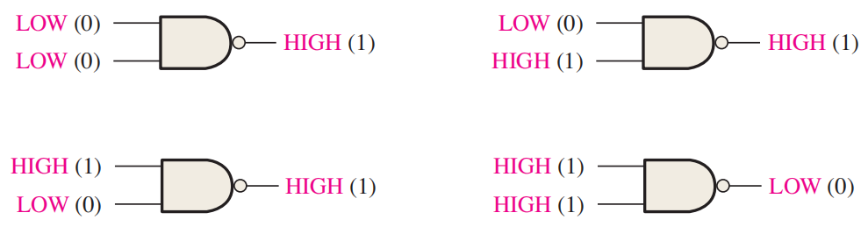
Theoretical Basis
Nand gate
The 2-input nand gate can be expressed as follows: If one input variable is A, if the other input variable is B, and if the output variable is X, then the Boolean expression is
This expression says that the two input variables, A and B, are first ANDed and then complemented, as indicated by the bar over the AND expression.
Truth table for NAND
Input |  | Output
A | B | X
0 | 0 | 1
0 | 1 | 1
1 | 0 | 1
1 | 1 | 0

Slide 6

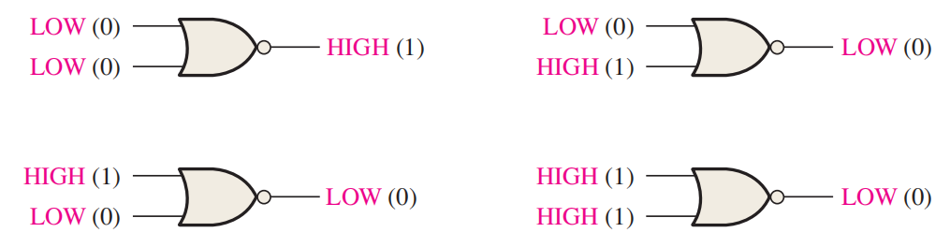
Theoretical Basis
Nor gate
The 2-input nor gate can be expressed as follows: If one input variable is A, if the other input variable is B, and if the output variable is X, then the Boolean expression is
This equation says that the two input variables are first ORed and then complemented, as indicated by the bar over the OR expression.
Truth table for NOR
Input |  | Output
A | B | X
0 | 0 | 1
0 | 1 | 0
1 | 0 | 0
1 | 1 | 0

Slide 7
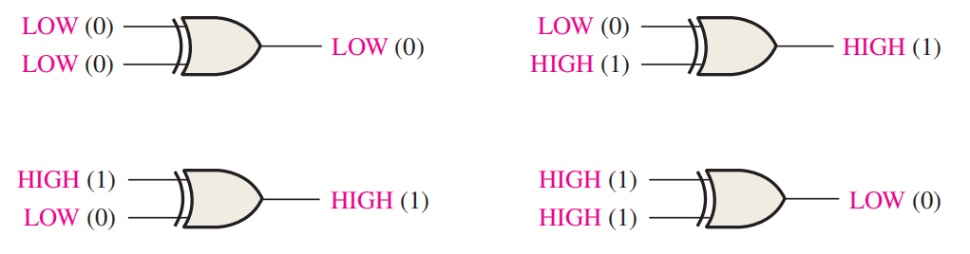
Theoretical Basis
Xor gate
The 2-input xor gate can be expressed as follows: output X is HIGH when input A is LOW and input B is HIGH, or when input A is HIGH and input B is LOW; X is LOW when A and B are both HIGH or both LOW.
Truth table for XOR
Input |  | Output
A | B | X
0 | 0 | 0
0 | 1 | 1
1 | 0 | 1
1 | 1 | 0

Slide 8
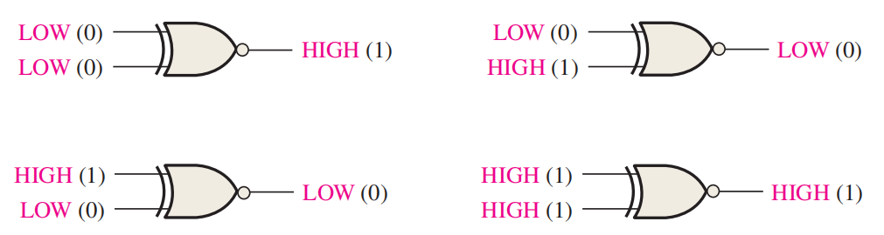
Theoretical Basis
Xnor gate
The 2-input xnor gate can be expressed as follows: output X is LOW when input A is LOW and input B is HIGH, or when A is HIGH and B is LOW; X is HIGH when A and B are both HIGH or both LOW.
Truth table for XNOR
Input |  | Output
A | B | X
0 | 0 | 1
0 | 1 | 0
1 | 0 | 0
1 | 1 | 1

Slide 9
Experiments
Experimental purposes
Understand the functions of different logical gates.
How to use the Quartus II software?
Verify the function for different logical gates or simple gage hybrid.

Slide 10
Experimental software
Quartus II 13.0 above Altera_ FPGA development environment
Refer to the textbook to be familiar with the basic development steps of Quartus II.

Slide 11
Experiments
Copy the “Quartus II 13.1” folder to the local disk in your computer.
Apply the “QuartusSetup-13.1.0.162.exe” file, flowing the guide. It will take about half or one hour to finish the setup process. And then you will see the “Altera 13.1.0.162” application in the start menu.

Slide 12
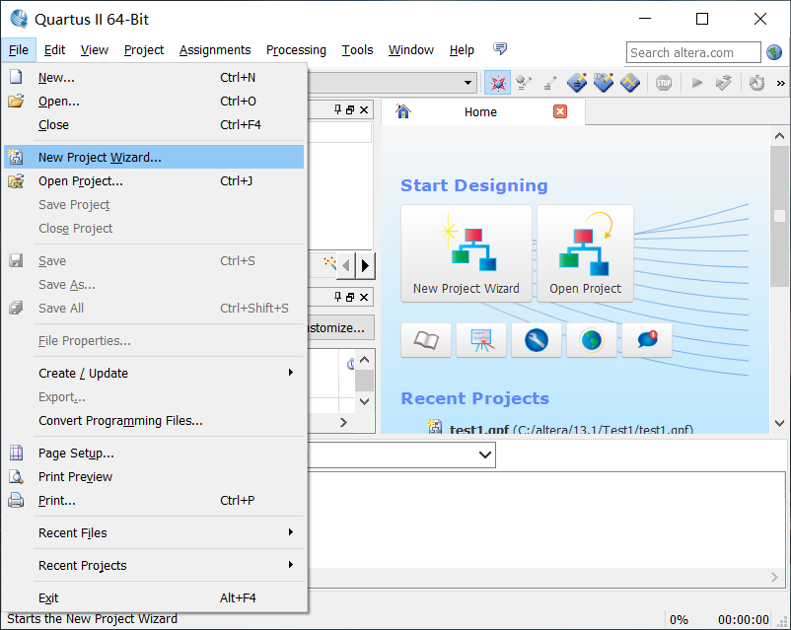
Experiments
1.Create a new project
Step1: File->New Project Wizard

Slide 13
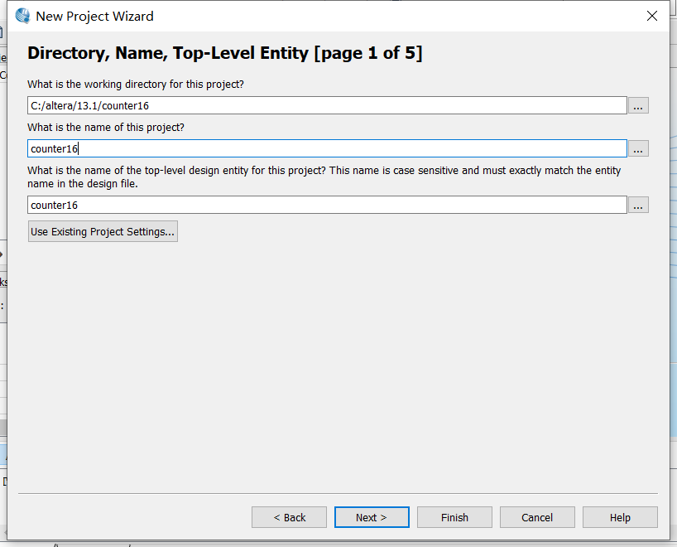
Experiments
1.Create a new project
Step2:
(1)Set the working directory of this project
(2) Set the name of this project

Slide 14
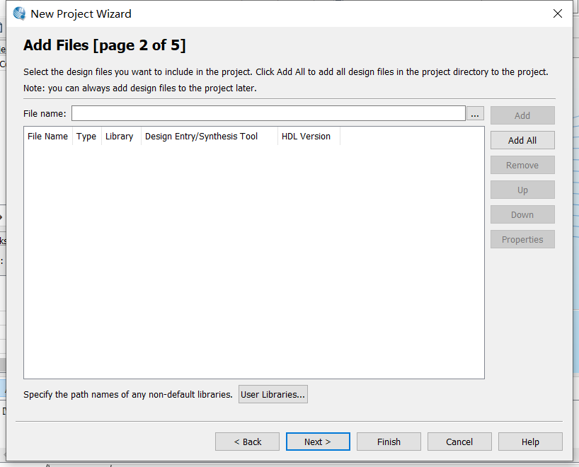
Experiments
1.Create a new project
Step3: Select the design files you want to include in the project.
As a new designing, you can pass this step!

Slide 15
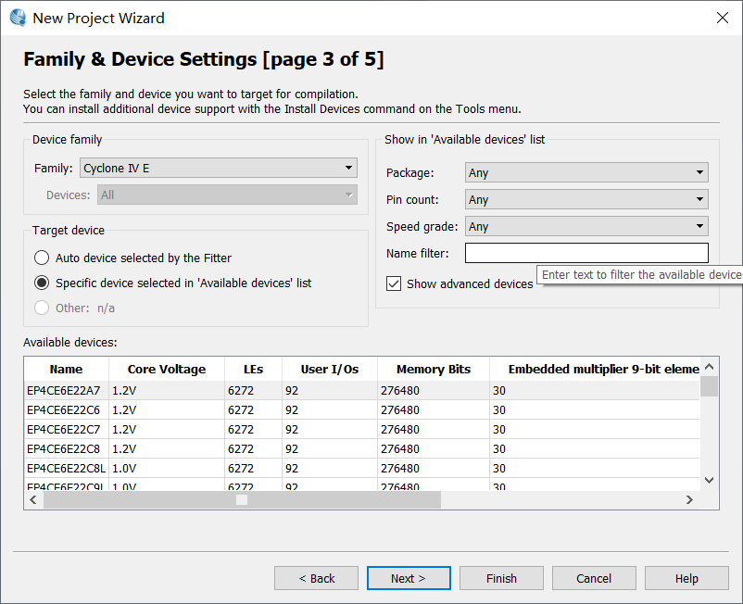
Experiments
1.Create a new project
Step4:
(1) Select the programmable devices
(2) Select cyclone family cyclone_ IV_ E

Slide 16
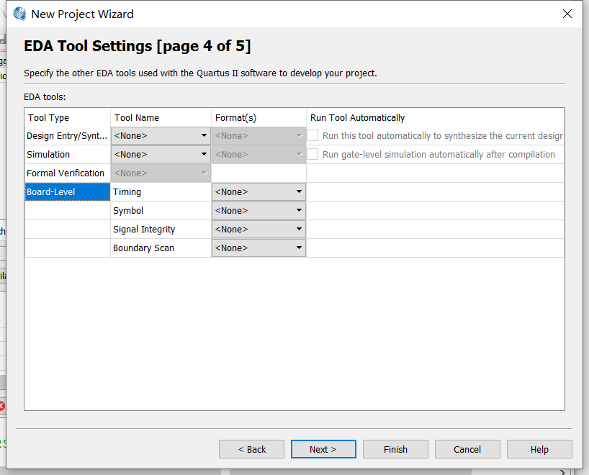
Experiments
1.Create a new project
Step5:
Select the external EDA tools used in the project.
You can pass this step!

Slide 17
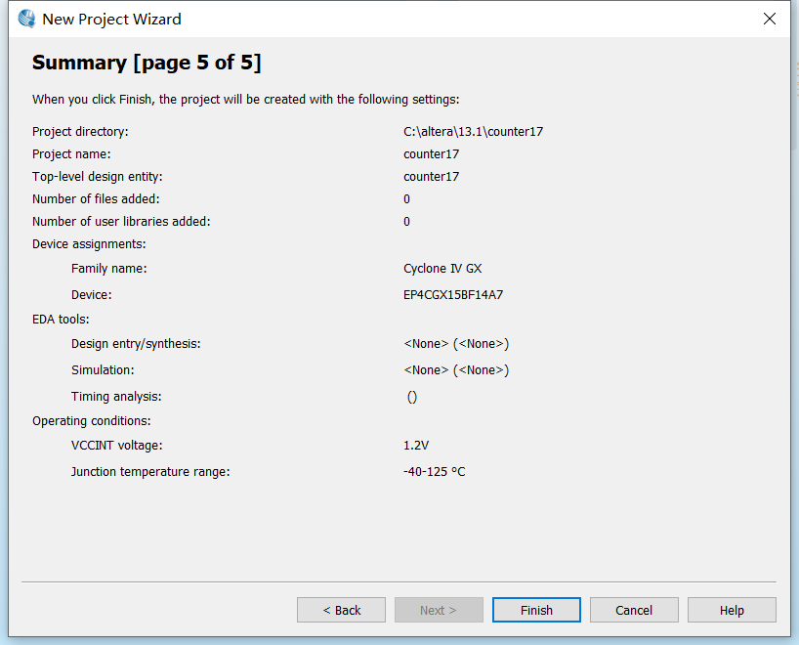
Experiments
1.Create a new project
Step6:
Confirm the configration for this project.

Slide 18
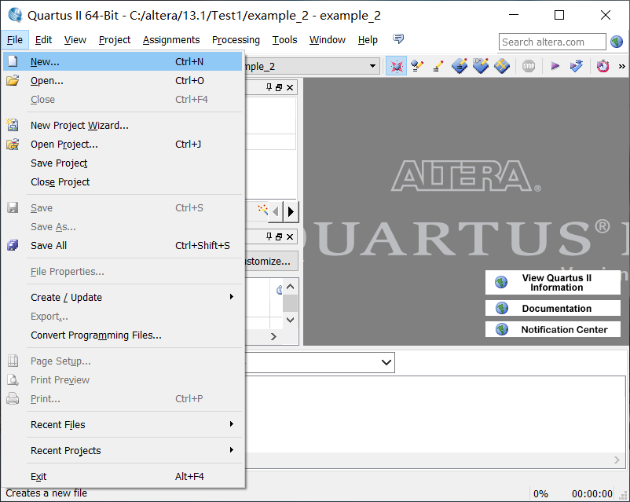
Experiments
2.Creat a design File
Step 1: File->New

Slide 19
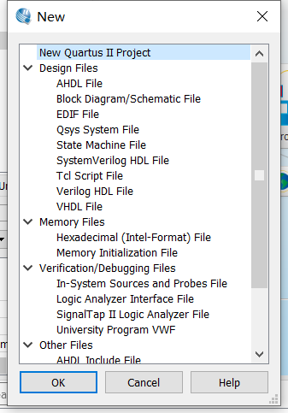
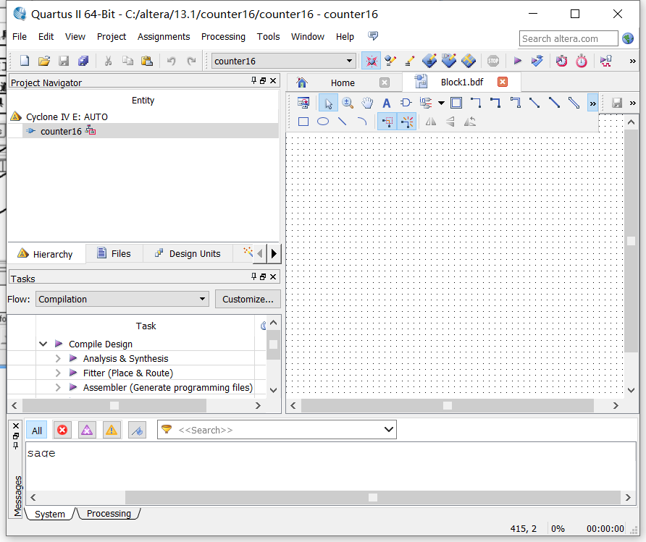
Experiments
2.Creat a design File
Step 2: Select the proper type of the design file you want
Successful!

Slide 20
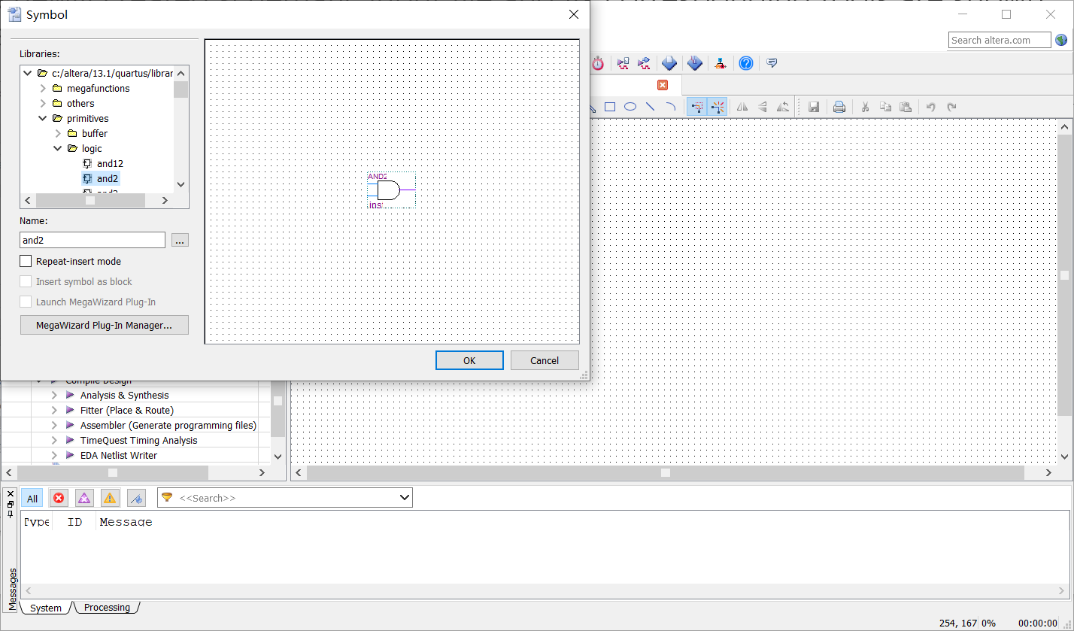
Experiments
2.The newly created schematic input file and its corresponding tools are shown in the figure right.
3. Virtual simulation
Task 1: 'and' logical operation test
Step 1: Double click the main board to open the libraries.
Step 2: Select the 'and2' element.

Slide 21
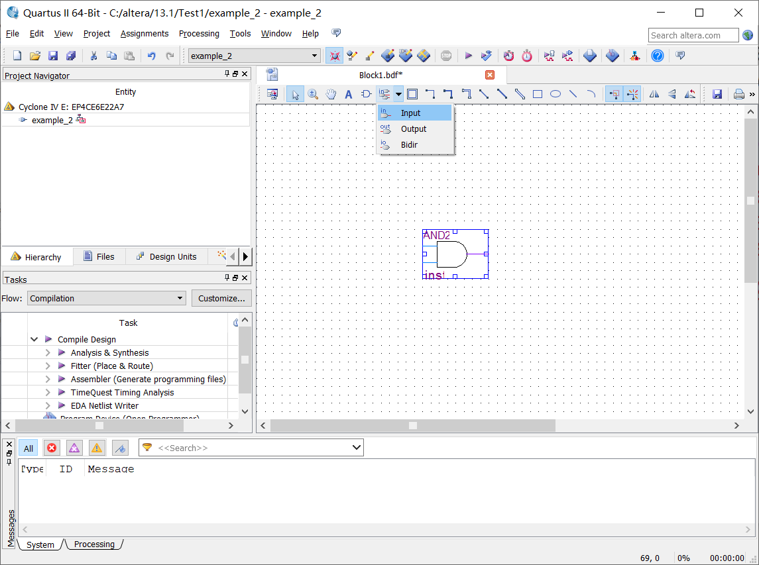
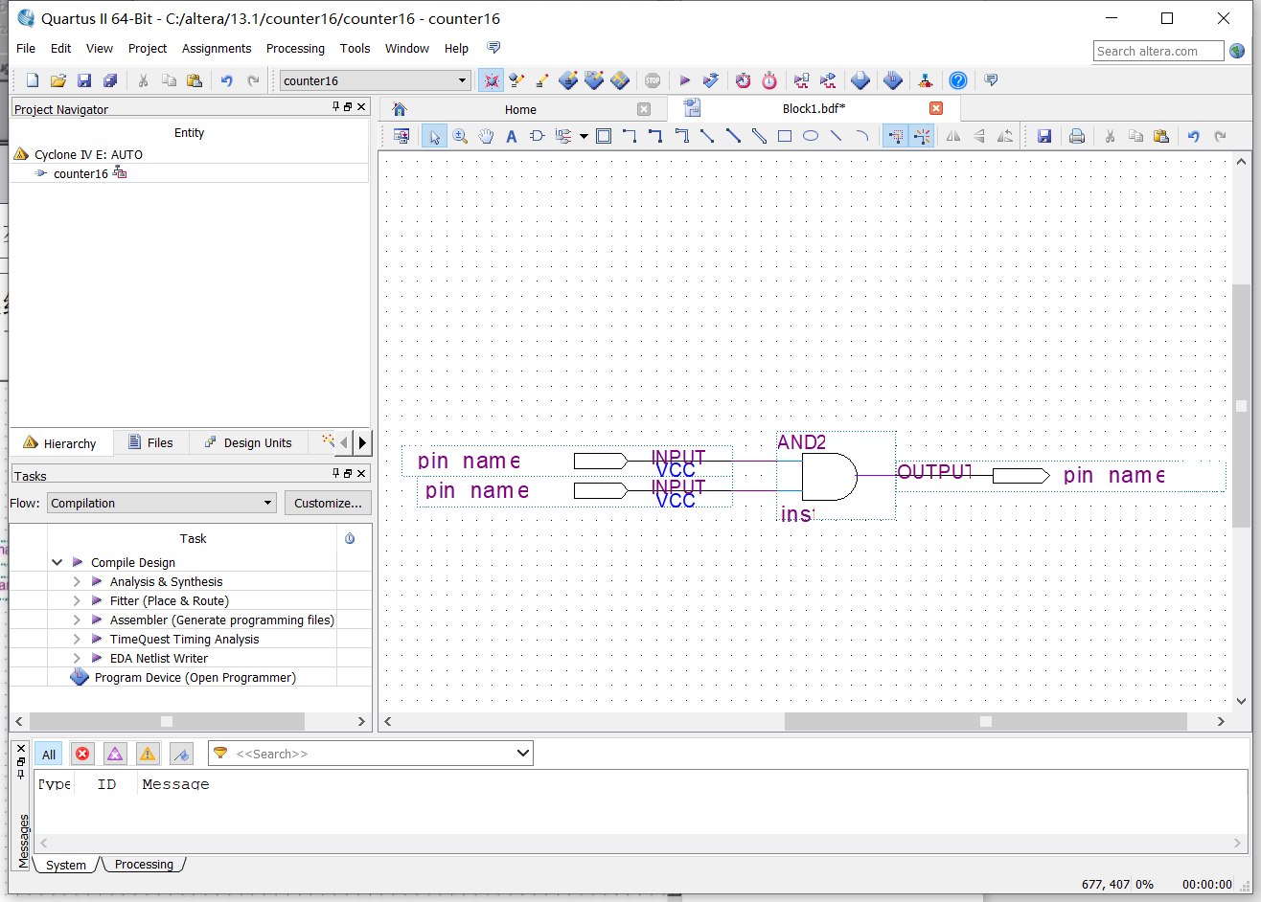
Experiments
3. Virtual simulation
Task 1: 'and' logical operation test
Step 3: Add the 'input' and 'output' to the 'and'

Slide 22
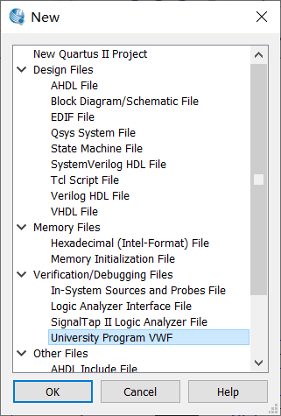
Experiments
3. Virtual simulation
Task 1: 'and' logical operation test
Step 4: Save this design file.
Step 5:File->New ->VMF

Slide 23
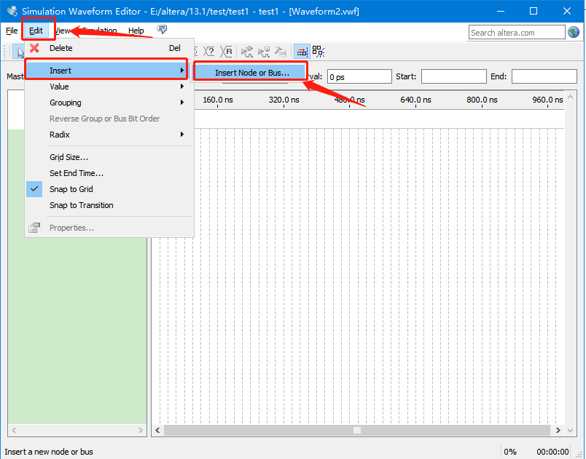
Experiments
3. Virtual simulation
Task 1: 'and' logical operation test
Step 6: Edit->Insert ->Insert Node or ...

Slide 24
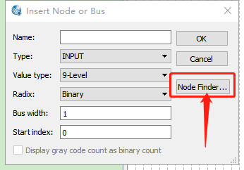
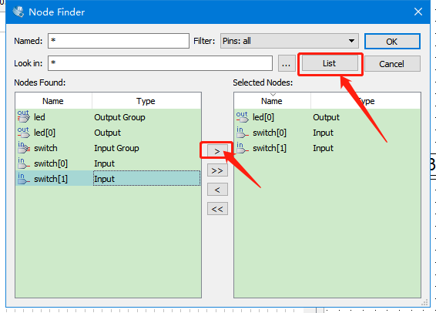
Experiments
3. Virtual simulation
Task 1: 'and' logical operation test
Step 7: Click 'Node Finder'
Step 8: Add input and output point

Slide 25
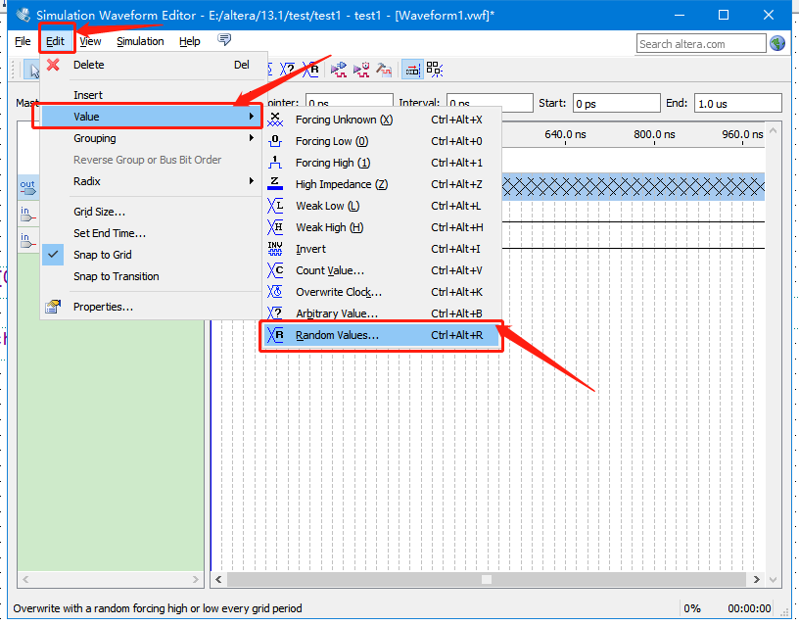
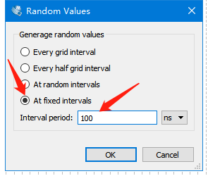
Experiments
3. Virtual simulation
Task 1: 'and' logical operation test
Step 9: Edit->Value ->Random Values
Step 10: Set input signal.Random Values select 'At fixed inervals',set the inerval period at 100ns.

Slide 26
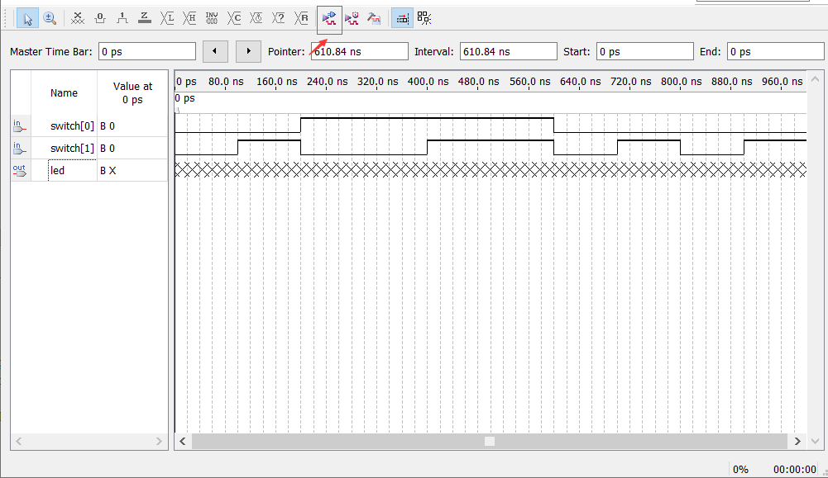
Experiments
3. Virtual simulation
Task 1: 'and' logical operation test
Step 11: Run functional simulation

Slide 27
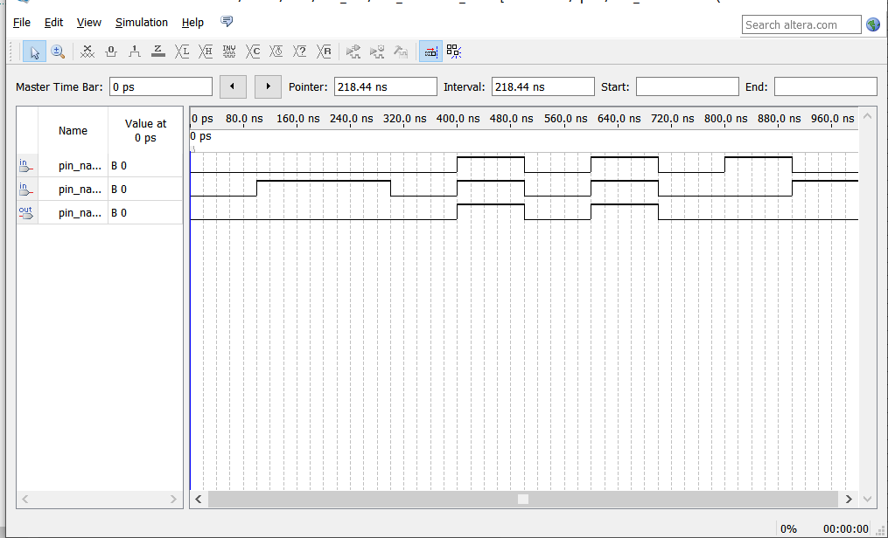
Experiments
3. Virtual simulation
Task 1: 'and' logical operation test
Step 12: Fill the results into Table 1, and save this fiure to draw the conclusions in your report.

Slide 28
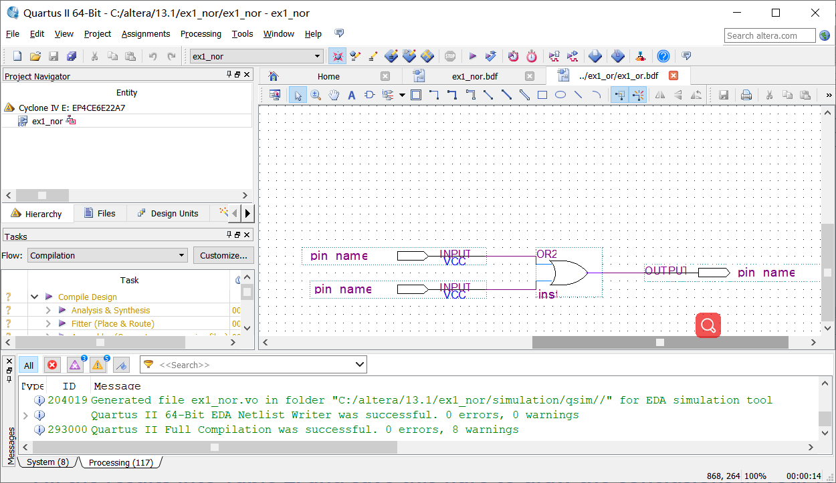
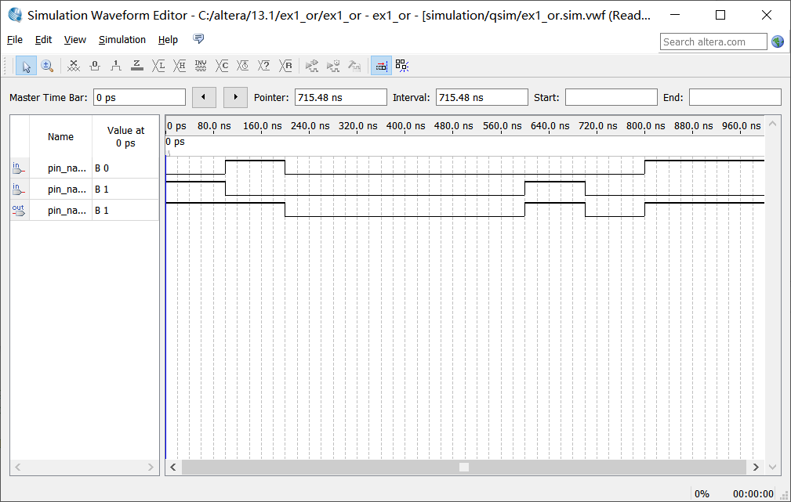
Experiments
Step 1: Design simulation circuit
Step 2: Run functional simulation
3. Virtual simulation
Task 2: 'or' logical operation test
Fill the results into Table 2, and save this fiure to draw the conclusions in your report.

Slide 29
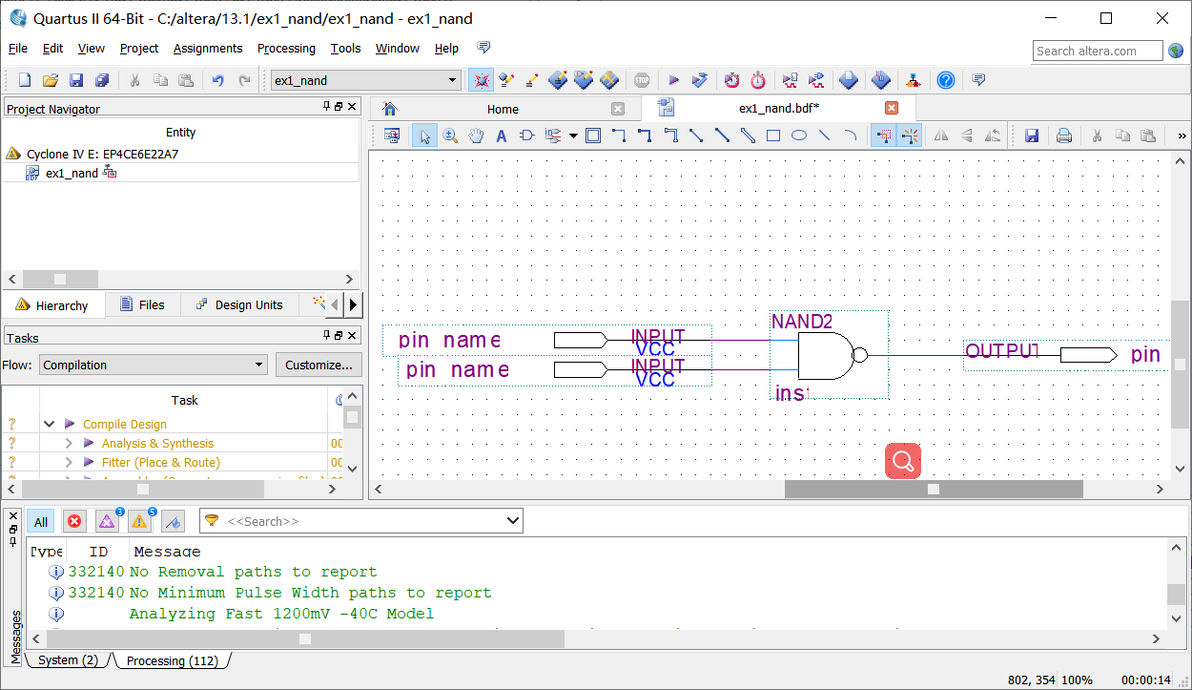
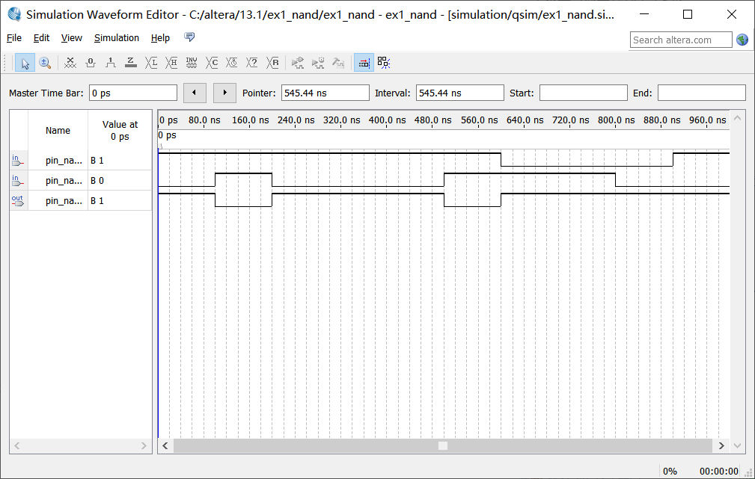
Experiments
Step 1: Design simulation circuit
Step 2: Run functional simulation
3. Virtual simulation
Task 3: 'nand' logical operation test
Fill the results into Table 3, and save this fiure to draw the conclusions in your report.

Slide 30
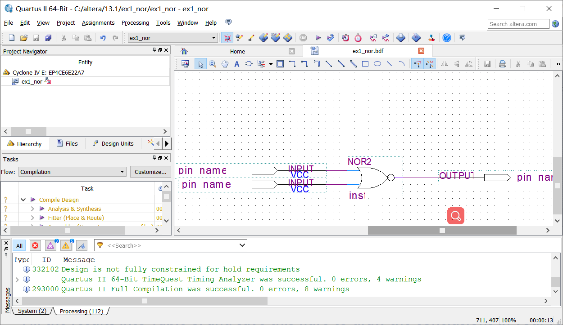
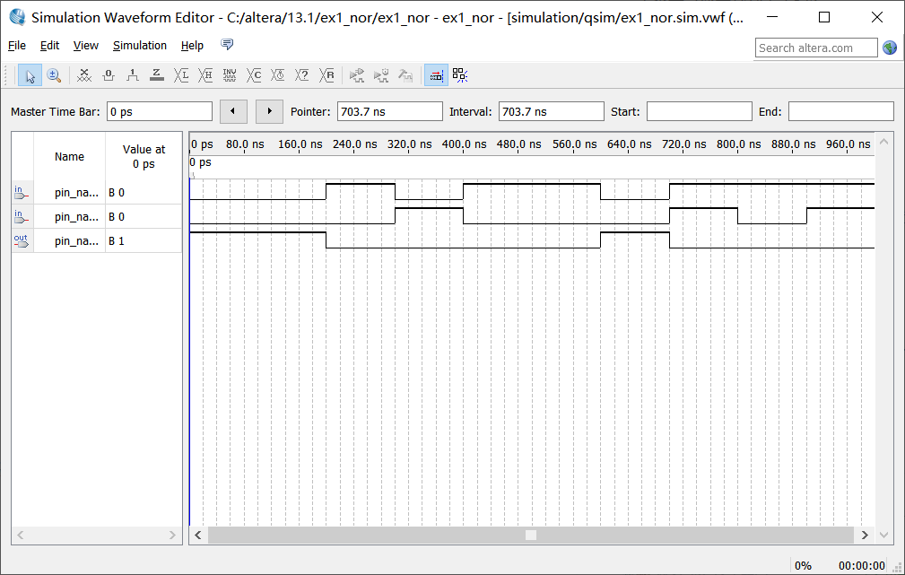
Experiments
Step 1: Design simulation circuit
Step 2: Run functional simulation
3. Virtual simulation
Task 4: 'nor' logical operation test
Fill the results into Table 4, and save this fiure to draw the conclusions in your report.

Slide 31
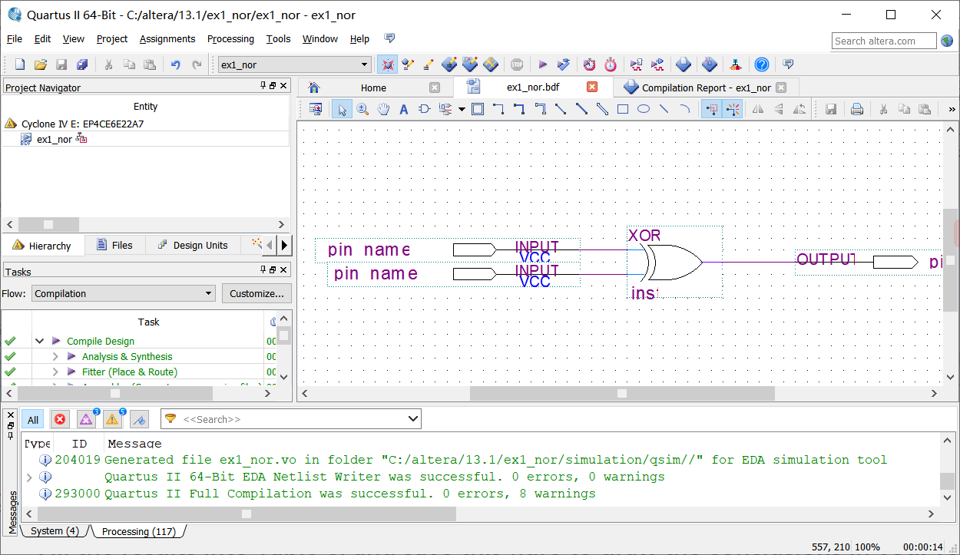
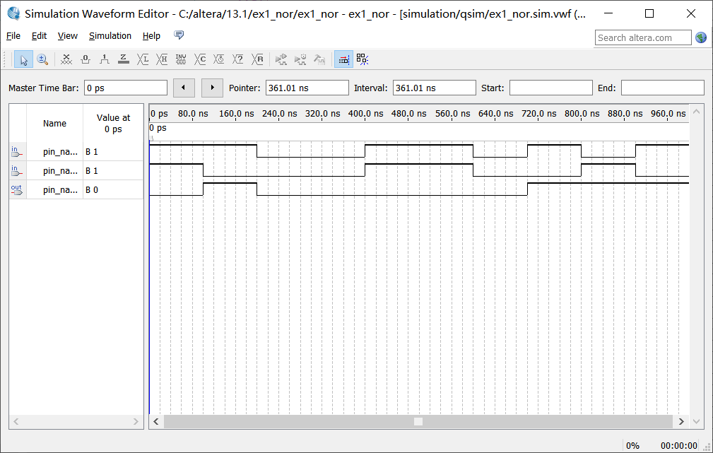
Experiments
Step 1: Design simulation circuit
Step 2: Run functional simulation
3. Virtual simulation
Task 6: 'xor' logical operation test
Fill the results into Table 6, and save this fiure to draw the conclusions in your report.

Slide 32
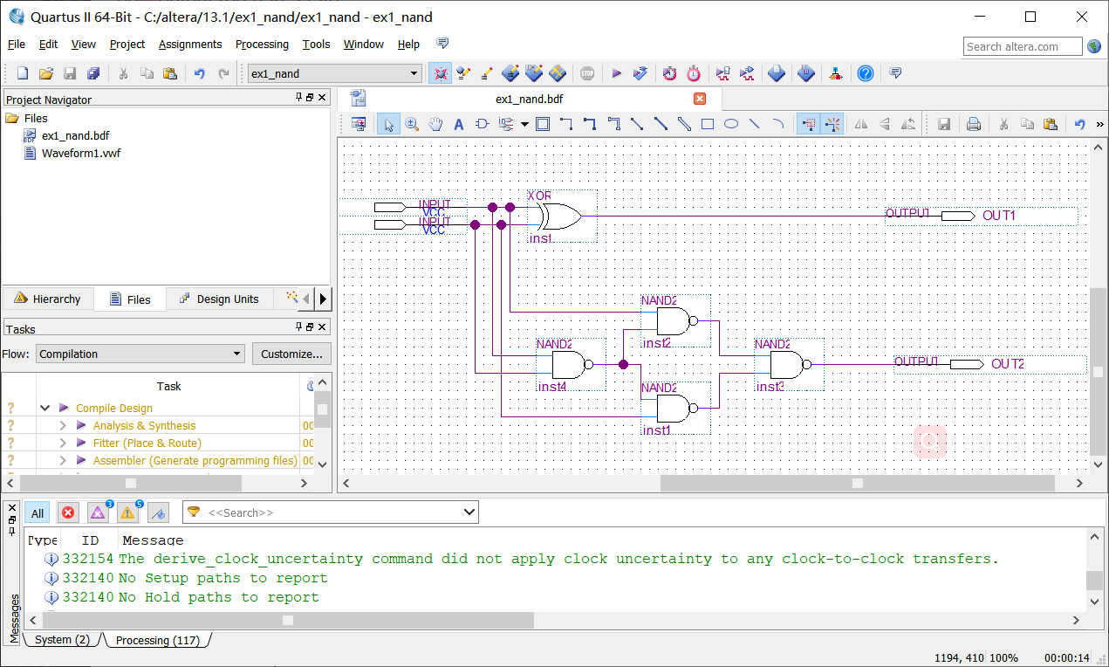
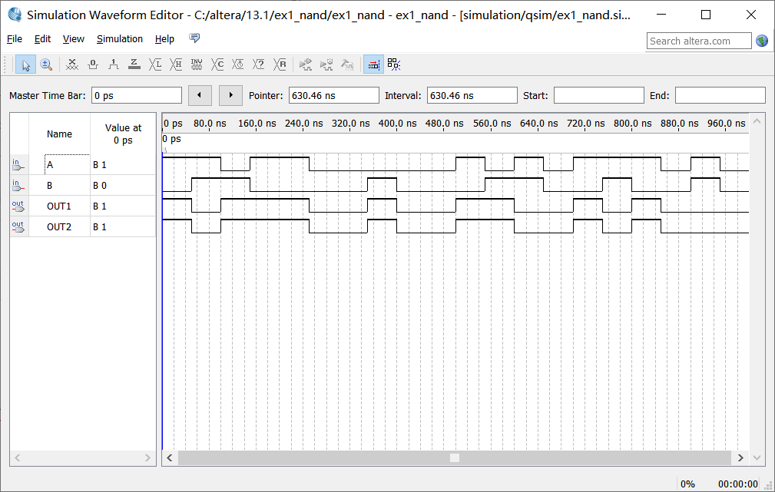

Experiments
Step 1: Design simulation circuit
Step 2: Run functional simulation
3. Virtual simulation
Task 7: Basic logical function for 'nand'
Fill the results into Table 7, and save this fiure to draw the conclusions in your report.

Slide 33
Thanks

